Slide 1
CS 1103 Final Project
Daniella Overko

Slide 2
Project Overview
Database for a bookshop
Entities: Book and Member
Relationship: Bought
Check inventory, filter books, enforce member rewards system, etc.

Slide 3
Entity DDL Statement
CREATE TABLE book
(ID VARCHAR(6),
title VARCHAR(50) NOT NULL,
author VARCHAR(20),
genre VARCHAR(20),
price NUMERIC(6,2) CHECK (price >= 0),
COPIES NUMERIC(4,0) CHECK (copies >= 0),
PRIMARY KEY (ID)
);
CREATE TABLE member
(member_id VARCHAR(5),
name VARCHAR(20),
email VARCHAR(40),
PRIMARY KEY (member_id)
);

Slide 4
Relationship DDL Statement
CREATE TABLE bought
(member_id VARCHAR(5),
ID VARCHAR(6),
date VARCHAR(10),
PRIMARY KEY (ID, member_id),
FOREIGN KEY (member_id) REFERENCES member (member_id)
ON DELETE CASCADE,
FOREIGN KEY (ID) REFERENCES book (ID)
ON DELETE CASCADE
);

Slide 5
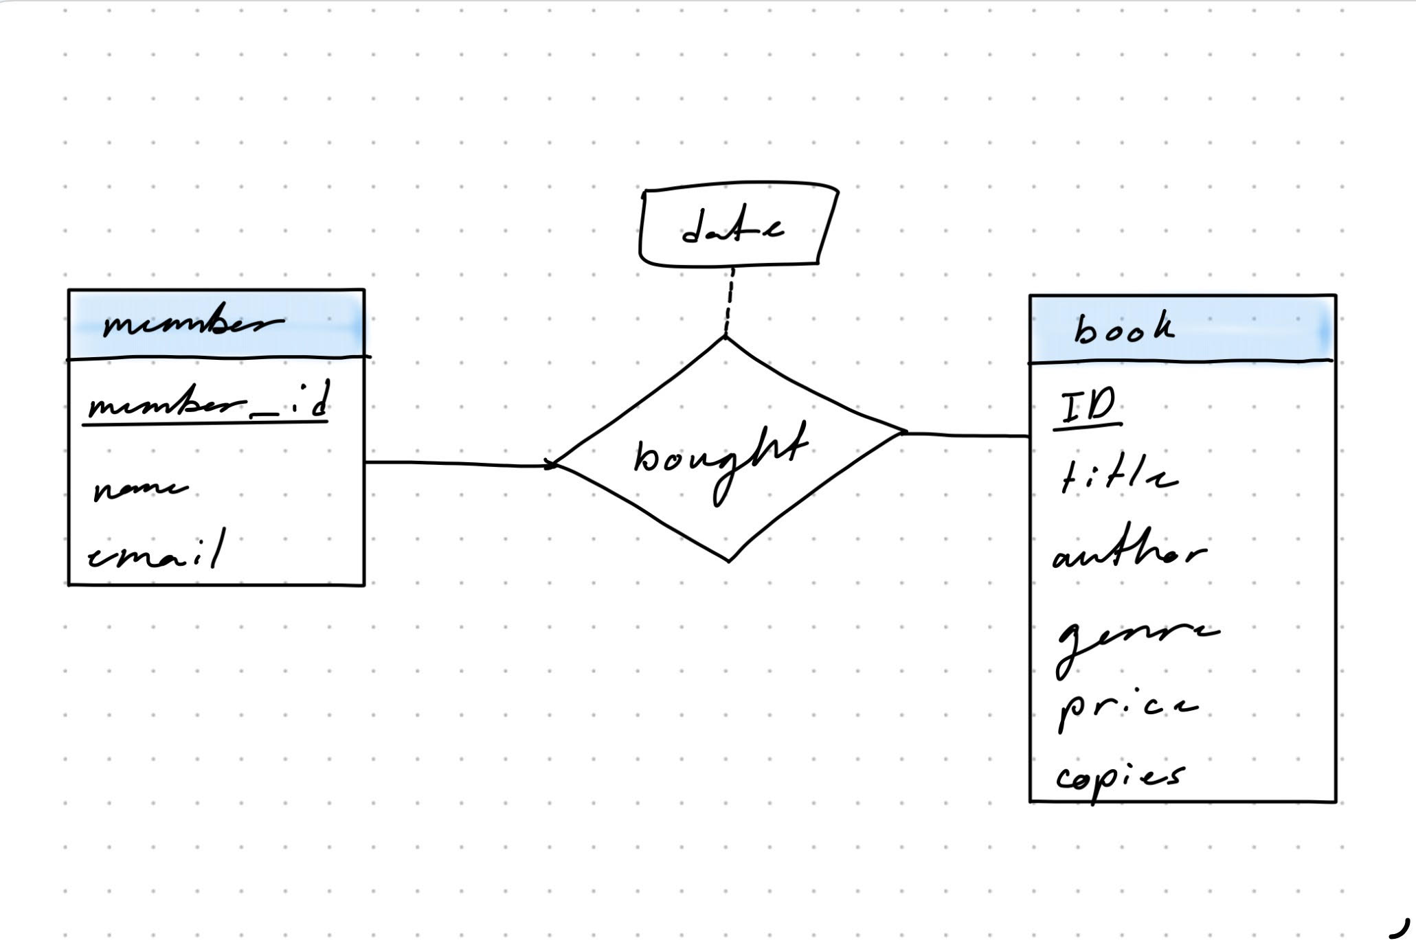
DDL Statements: Relation to ER Diagram

Slide 6
Sample Insert Statements
INSERT INTO book VALUES('111111', 'Little Women', 'Louisa May Alcott', 'Coming-of-Age', 12.00, 10);
INSERT INTO book VALUES('111112', 'Anne of Green Gables', 'L. M. Montgomery', 'Coming-of-Age', 12.00, 15);
INSERT INTO book VALUES('111113', 'Mistborn', 'Brandon Sanderson', 'Fantasy', 14.99, 8);
INSERT INTO book VALUES('111114', 'Klara and the Sun', 'Kazuo Ishiguro', 'Literary Fiction', 25.75, 5);
INSERT INTO book VALUES('111115', 'A Man Called Ove', 'Fredrik Backman', 'Literary Fiction', 18.99, 6);
INSERT INTO book VALUES('111116', 'Nightshade Academy', 'Mel Torrefranca', 'Fantasy', 25.99, 4);
INSERT INTO book VALUES('111117', 'Cinder', 'Marissa Meyer', 'Fantasy', 21.00, 9);
INSERT INTO book VALUES('111118', 'The Hunger Games', 'Suzanne Collins', 'Dystopian', 18.39, 8);
INSERT INTO member VALUES('12345', 'Jane Doe', 'jane.doe@gmail.com');
INSERT INTO member VALUES('23456', 'John Doe', 'johndoe@gmail.com');
INSERT INTO bought VALUES('12345', '111111', '03/11/2026');
INSERT INTO bought VALUES('12345', '111112', '03/11/2026');
INSERT INTO bought VALUES('23456', '111113', '04/12/2026’);
INSERT INTO bought VALUES('23456', '111111', '05/01/2026');

Slide 7
JDBC
https://github.com/Daniella-Overko/CS-1103-Final-Project/blob/main/Bookstore.java

Slide 8
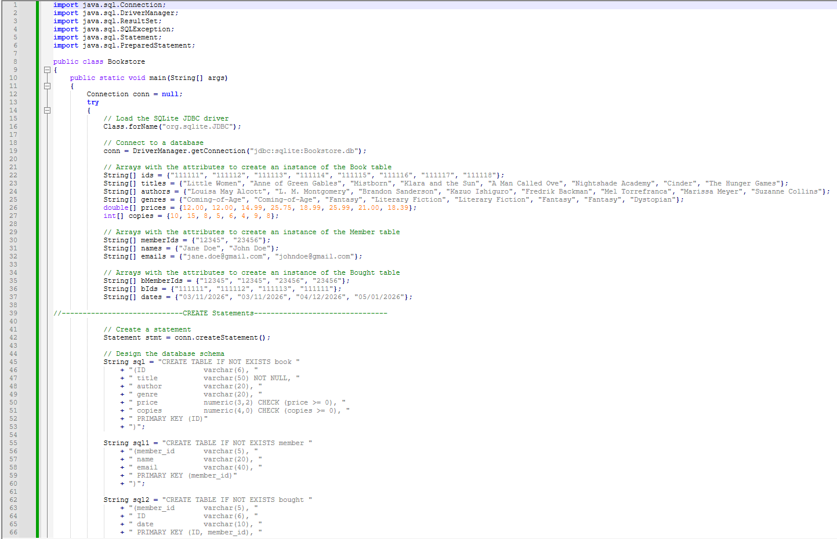

Slide 9
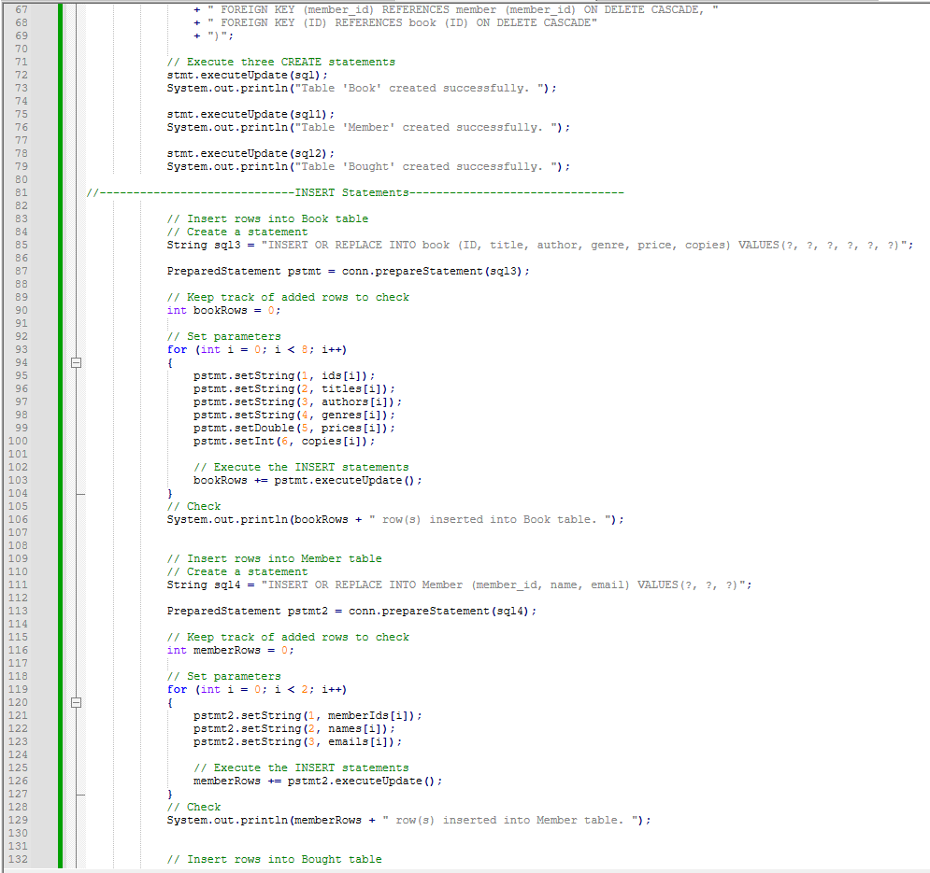

Slide 10
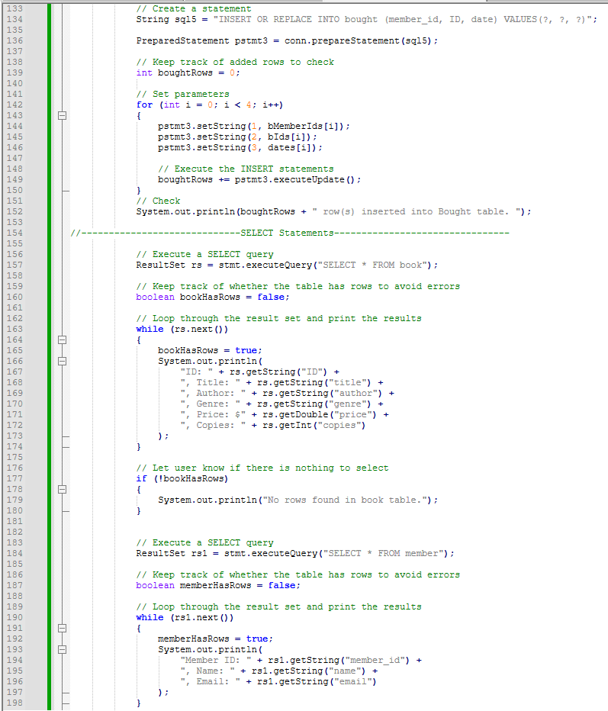

Slide 11
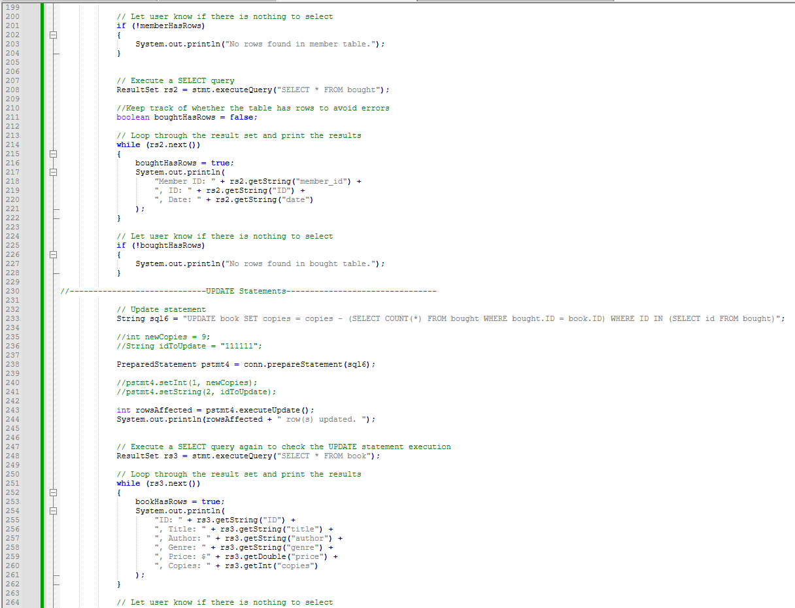

Slide 12
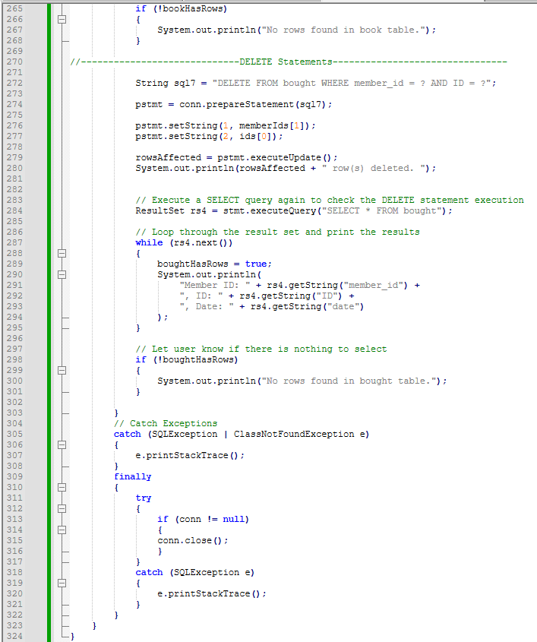

Slide 13
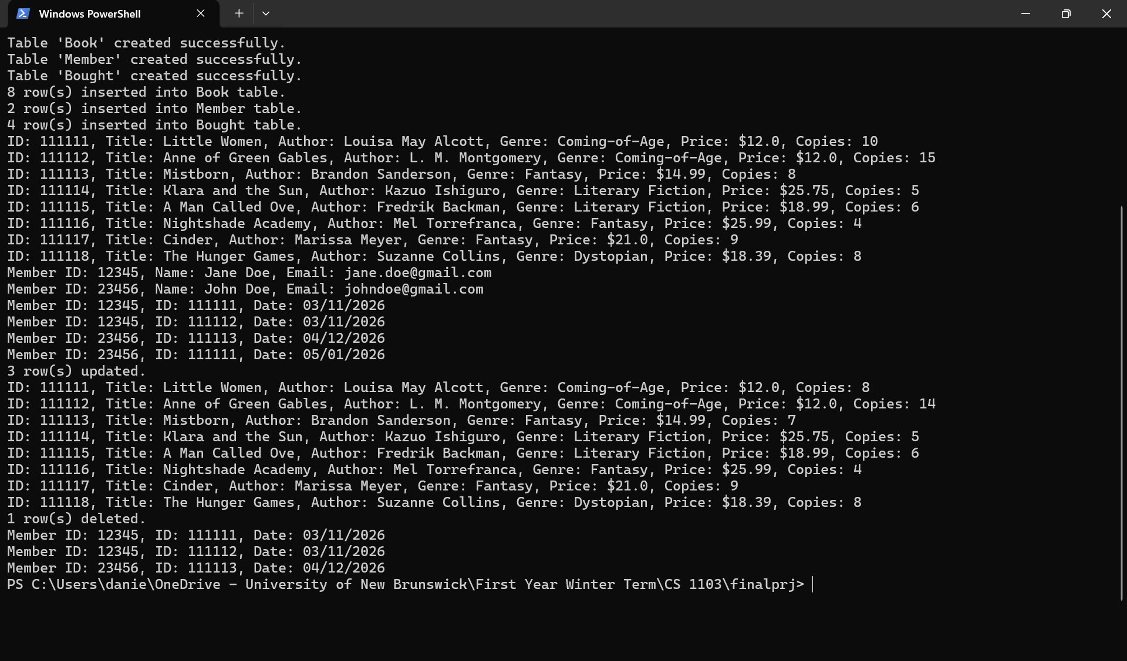

Slide 14
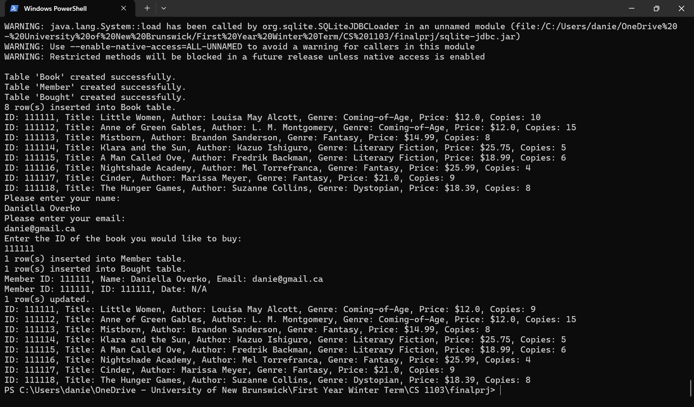

Slide 15
Thank You

